Slide 1
CERTIFIED JENKINS ENGINEER 2017
Quick Notes/Summary

Slide 2
CHAPTER 1 – KEY CI / CD CONCEPTS

Slide 3
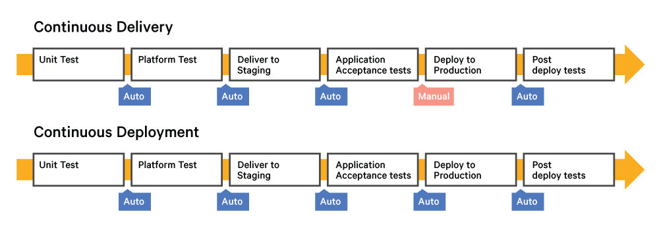
Continuous Delivery/Continuous Integration Concepts
CI
Continuous Integration (CI) is a development practice that requires developers to integrate code into a
shared repository several times a day,
Each check-in is then verified by an automated build, allowing teams to detect problems early
Continuous Deployment [ CD ]
Continuous Deployment is a software development practice in which every code change goes through the entire pipeline and is put into production, automatically, resulting in many production deployments every day
CD [ CDY ]
Continuous Delivery is the natural extension of Continuous Integration, an approach in which teams
ensure that every change to the system is releasable, and release any version with the push of a button.
Diff bw Continuous Delivery & Deployment is
User to Decide & Initiate Prod Deploy
C Delivery is Code Ready for Deploy- Post Manual
Decision, Code will be promoted/released to Prod
C Deployment – Code will be Auto Deployed, Seamless
manner no manual interventions

Slide 4
CI practices
Single source repository
Automate the build
Make your build self testing
Everyone commits everyday
Every commit triggers a build
Fix broken builds immediately
Keep the commit build fast (and use pipeline for slower builds)
Store the Build Artifacts
Test in a clone of the prod environment
Make it easy to get the latest build
Visibility [ Notification on Build Status/Failures, Build Changes etc to be transparent ]
Automate deployment
Continuous Deploy principles
Check in
Build and unit tests
Automated acceptance tests
User acceptance test
Release through Deployment Pipeline
Continuous Delivery Benefits
Reduced Deployment Risk
Believable(& User Quantifiable) Progress
Prompt User Feedback
User acceptance test (Re-Execute or sample random test again to certify)
Release/Deploy based on User Approval
https://www.martinfowler.com/articles/continuousIntegration.html
Continuous Delivery is a software development discipline where you build software in such a way that the software can be released to production at any time.
You’re doing continuous delivery when: [1]
Your software is deployable throughout its lifecycle
Your team prioritizes keeping the software deployable over working on new features
Anybody can get fast, automated feedback on the production readiness of their systems any time somebody makes a change to them
You can perform push-button deployments of any version of the software to any environment on demand

Slide 5
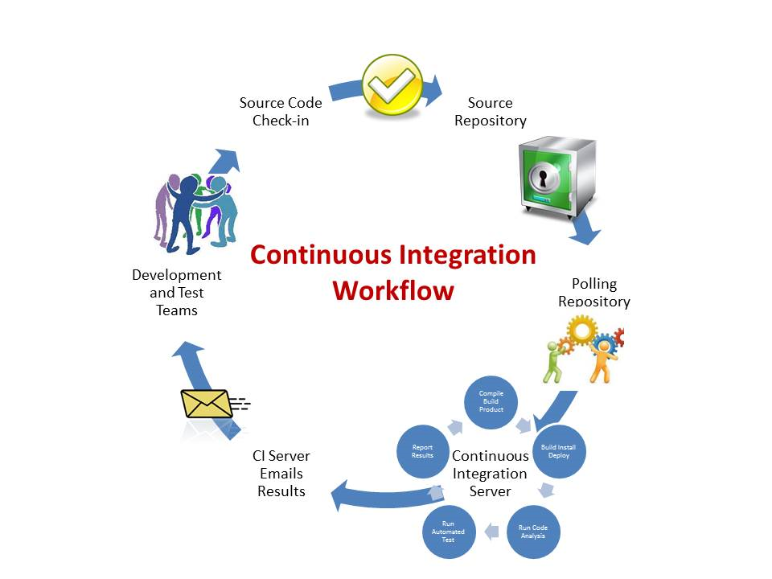
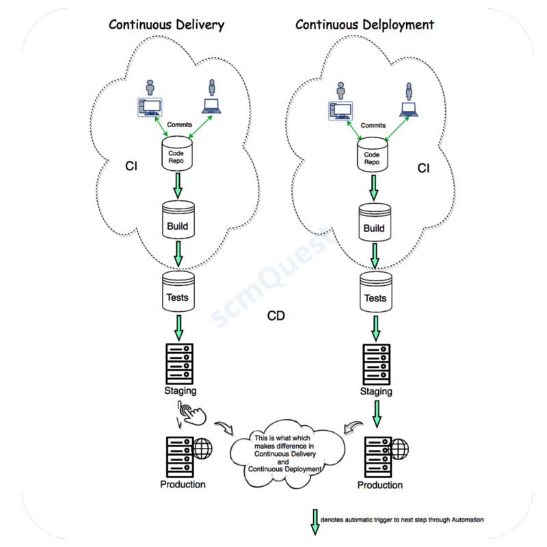
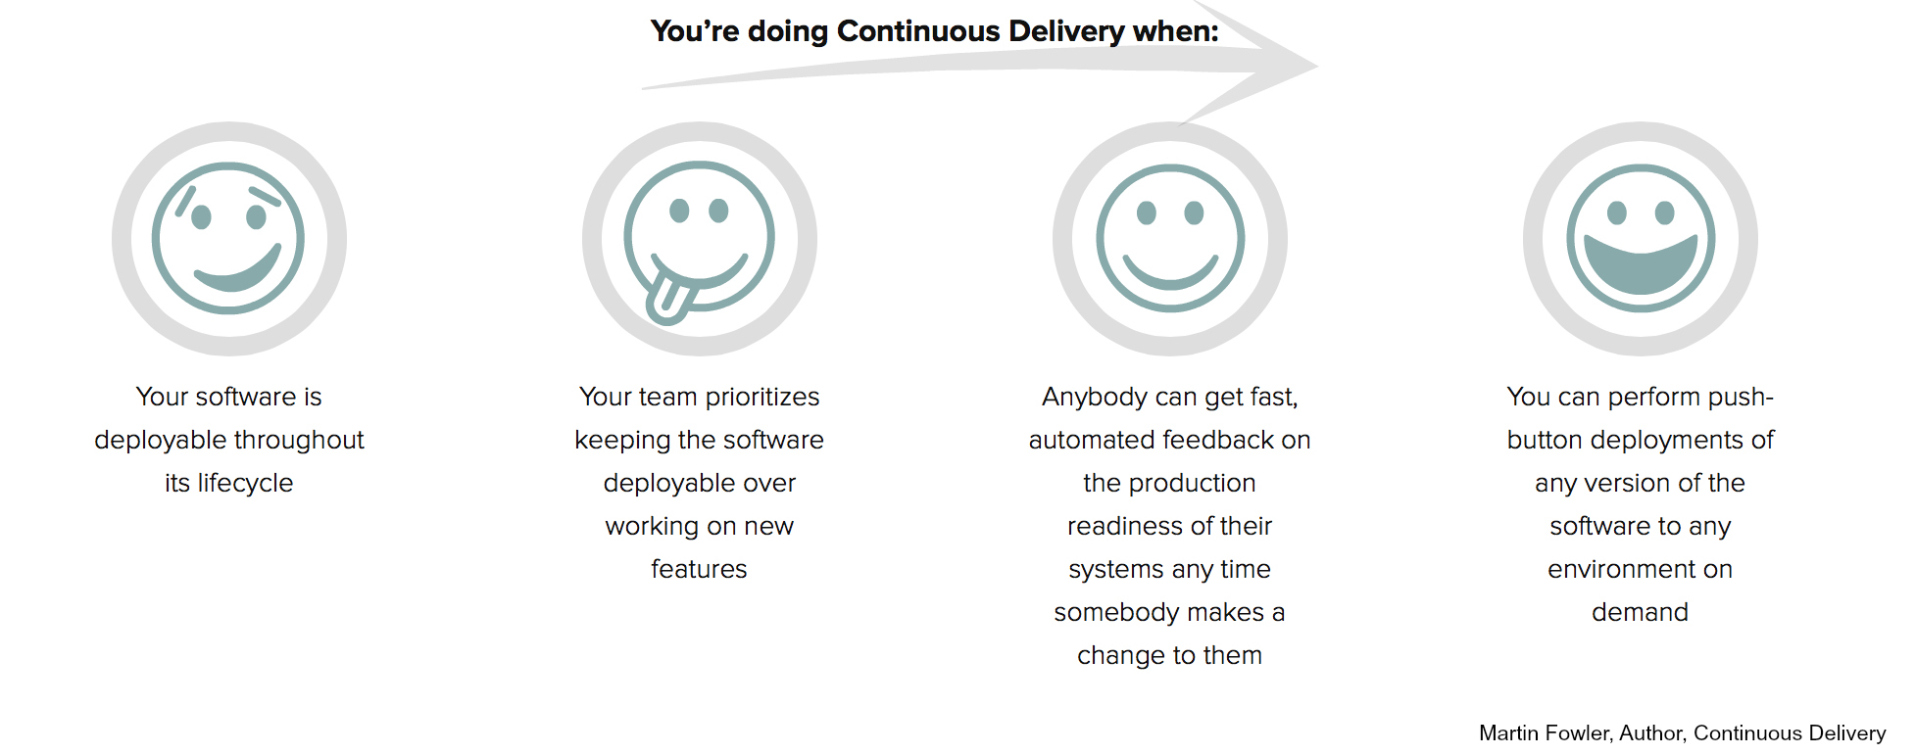
Stages of CI/CD/CDY
Imgs Credit : http://scmquest.com/continuous-integration-vs-continuous-delivery-vs-continuous-deployment/

Slide 6
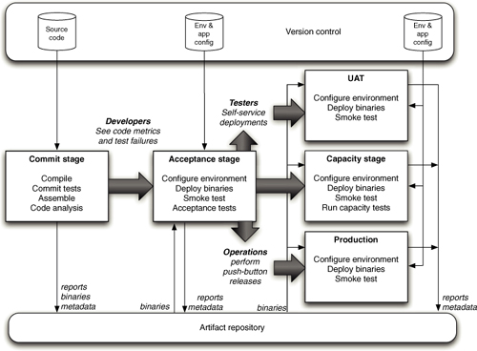
Deployment Pipeline - Concepts
http://www.informit.com/articles/article.aspx?p=1621865&seqNum=2
At an abstract level, a deployment pipeline is an automated manifestation of your process for getting software from version control into the hands of your users
Every change to your software goes through a complex process on its way to being released. That process involves building the software, followed by the progress of these builds through multiple stages of testing and deployment. This, in turn, requires collaboration between many individuals, and perhaps several teams
The deployment pipeline models this process, and its incarnation in a continuous integration and release management tool is what allows you to see and control the progress of each change as it moves from version control through various sets of tests and deployments to release to users
Deployment Pipeline - Stages
Sample Deployment Pipeline
The commit stage asserts that the system works at the technical level. It compiles, passes a suite of (primarily unit-level) automated tests, and runs code analysis.
Automated acceptance test stages assert that the system works at the functional and nonfunctional level, that behaviorally it meets the needs of its users and the specifications of the customer.
Manual test stages assert that the system is usable and fulfills its requirements, detect any defects not caught by automated tests, and verify that it provides value to its users. These stages might typically include exploratory testing environments, integration environments, and UAT (user acceptance testing).
Release stage delivers the system to users, either as packaged software or by deploying it into a production or staging environment (a staging environment is a testing environment identical to the production environment).

Slide 7
Orchestrating a process (Pipeline Jobs – Orchestration)
You’ve defined your pipeline; now you need to orchestrate it. This is a long process, but here are a few steps you’ll want to take – as outlined in a whitepaper by Xebia Labs’ Andrew Phillips and CloudBees’ Kohsuke Kawaguchi.
Ensure reproducible builds – Configure the build system to use a clean repository connected to the build job’s workspace and use a central shared repository for build dependencies.
Share build artefacts through the pipeline – Ensure the candidate artefact is used by all subsequent builds in your pipeline.
Choose the right granularity for each job – Distribute all steps in the pipeline across multiple jobs, allowing you to identify bottlenecks more easily.
Parallelizing & Joining Jobs - Especially when running multi-platform tests, but also if we are building artifacts for different target platforms, we want to make our pipeline as efficient as possible by running builds in parallel
Gates & Approval - As the pipeline stages get closer to the QA and Production environments, many organizations require some form of sign-off or approval before tasks can be carried out
Visualize the pipeline – Create a clear, accessible view of the build pipeline to allow for smooth status communications and transparency of the process to the business managers and other stakeholders.
Organizing & Securing Jobs –
It generally also requires us to adopt job naming conventions along the lines of myProject-myVersion-pipelinePhase, so that all jobs for a pipeline are listed together, and so that we can use regular expressions when defining views, rather than having to select pipeline jobs for a view individually.
We need to ensure that different phases of the pipeline have different access control policies (in our example, developers are not authorized to trigger the QA jobs or the deployment to production)
Miscellaneous Best Practices
Versioning your Jenkins configuration
Using Plugins to manage Access Control
Use Proper Naming Conventions for the Jobs & proper folder structure.
https://www.infoq.com/articles/orch-pipelines-jenkins#_Toc7

Slide 8
TOOLS Used for CI / CD / CDY
Source Code Repository Management Tools – (to Manage Code base development, Version, Branching/Merging/Tagging) - SVN, CVS, GitHub etc
Some of the commonly used CI tools are Jenkins, Hudson, Travis and Bamboo. Basic principle behind all of them is the detection of changes in the code repository and triggering a set of jobs(build) or tasks
Some of the commonly used tools for Storing Build Artifacts are Artifactory, Sonatype Nexus, Maven Artifact Repository, Apache Archiva etc
http://blogs.collab.net/subversion/why-you-should-be-using-an-artifact-repository-part-1#.WWxiwGBPrIU
What's the purpose of an artifact repository?
Jenkins stores the artifacts as plain files without versioning while artifacts in an artifact repository can be version controlled. So you have a lot more flexibility in retrieving artifacts and governing them. Read very good article on why we need them. Surely not all of those things are supported by continuous integration tools like Jenkins
"Moreover, you can also look at the Artifactory plugin for Jenkins which integrates the two
Some of the commonly used Unit Testing Tools – Junit, SOAP(WebServices), Jmeter, Mock Frameworks etc
Some of the commonly used Functional Testing Tools – Selenium(Web based), IBM RFT, UI Path etc
Some of the commonly used Performance Testing Tools – Jmeter, Jprofiler, Fiddler etc
Some of the commonly used tools for Configuration Management – [Managing/Deploying into Environments - IAAS] – Chef, Puppet, Ansible, SaltStack etc
Some of the commonly used tool to Provision an Consistent pre-set environment - Container Service - Docker

Slide 9
Job/Project
Jobs or Projects

Slide 10
Build Jobs/Project
Job aka Project
Build jobs are at the heart of the Jenkins build process
Think of a Jenkins build job as a particular task or step in your build process.
This may involve simply compiling your source code and running your unit tests. Or
you might want a build job to do other related tasks, such as running your integration tests, measuring code coverage or
code quality metrics, generating technical documentation, or even deploying your application to a web server.
A real project usually requires many separate but related build jobs
Types of jobs
Freestyle project
Maven project
Pipeline
Multi configuration
Multi branch
Long running
Scope of Jobs
Refer Folders & Templates

Slide 11
Build Jobs in Jenkins
Build jobs are the basic currency of a Continuous Integration server.
A build job is a particular way of compiling, testing, packaging, deploying or otherwise doing something
with your project.
Build jobs come in a variety of forms; you may want to compile and unit test your
application, report on code quality metrics related to the source code, generate documentation, bundle
up an application for a release, deploy it to production, run an automated smoke test, or do any number
of other similar tasks.
A software project will usually have several related build jobs. For example, you might choose to start
off with a dedicated build job that runs all of your unit tests. If these pass, you might proceed to a
build job that executes longer-running integration tests, runs code quality metrics, or generates technical
documentation, before finally bundling up your web application and deploying it to a test server.
Build Steps
Build steps are the basic building blocks for the Jenkins build process,
They are what let you tell Jenkins exactly how you want your project built.
A build job may have one step, or more.It may even occasionally have none.
In a freestyle build, you can add as many build steps as you want to the project Build configuration
In a basic Jenkins installation, you will be able to add steps to invoke Maven and Ant, as well as running OS-specific shell or Windows batch commands

Slide 12
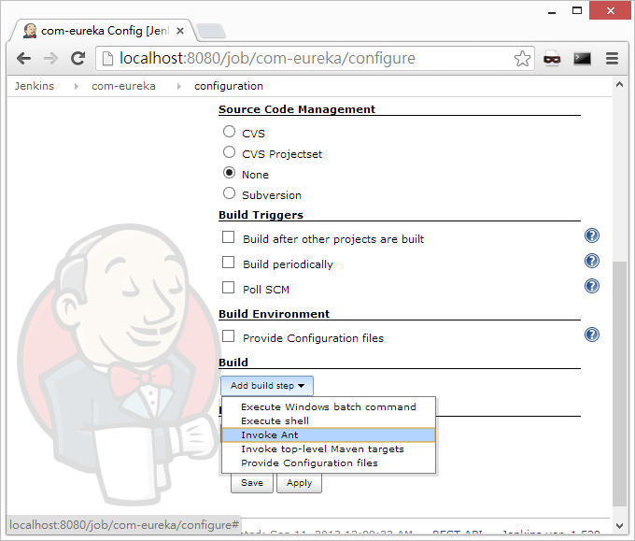
SCCM
Build Trigger
Build Step

Slide 13
Configuring Your Build Tools
Jenkins supports three principal build tools: Ant, Maven, and the basic shell-script (or Batch script in Windows).
Using Jenkins plugins, you can also add support for other build tools and other languages, such as Gant, Grails, MSBuild, and many more
We need to Configure the Jenkins – Maven(Install through Jenkins) , Jenkins –Ant, Jenkins –Shell
Read Jenkins Definitive Guide – Sec 4.6 completely

Slide 14
SCCM
Source Code Control Management

Slide 15
SCCM – Source Code Control Management
http://www.cio.com/article/2438652/developer/source-code-management-systems--trends--analysis-and-best-features.html
Basics
A source control management system (SCM) is software that provides coordination and services between members of a software development team
At the most basic level, it provides file management and version control so that team members don’t write over each other’s changes, and only the newest versions of files are identified for use in the workspace
SCMs also give developers the ability to work concurrently on files (in branches that may or may not converge),
Provides Ability to merge changes with other developers’ changes
Provides Ability to track and audit changes that were requested and made
Provides Ability to track bug-fix status and to perform releases
Provides 1 Centralized/Distributed Source Code repository for Developing/building/Releasing the project

Slide 16
Types of SCM [ Centralized & Distributed ]
https://www.atlassian.com/blog/software-teams/version-control-centralized-dvcs
Centralized version control systems are based on the idea that there is a single “central” copy of your project somewhere (probably on a server), and programmers will “commit” their changes to this central copy.
“Committing” a change simply means recording the change in the central system. Other programmers can then see this change. They can also pull down the change, and the version control tool will automatically update the contents of any files that were changed
Examples of Centralized Version Control - CVS, Subversion (or SVN) and Perforce
A Typical Centralized Version Control Workflow
When you’re working with a centralized verison control system, your workflow for adding a new feature or fixing a bug in your project will usually look something like this:
Pull down any changes other people have made from the central server.
Make your changes, and make sure they work properly.
Commit your changes to the central server, so other programmers can see them

Slide 17
Distributed SCM
https://www.atlassian.com/blog/software-teams/version-control-centralized-dvcs
In the past five years or so a new breed of tools has appeared: so-called “distributed” version control systems (DVCS for short). The three most popular of these are Mercurial, Git and Bazaar.
These systems do not necessarily rely on a central server to store all the versions of a project’s files.
Instead every developer “clones” a copy of a repository and has the full history of the project on their own hard drive. This copy (or “clone”) has all of the metadata of the original.
This method may sound wasteful, but in practice, it’s not a problem. Most programming projects consist mostly of plain text files (and maybe a few images), and disk space is so cheap that storing many copies of a file doesn’t create a noticable dent in a hard drive’s free space. Modern systems also compress the files to use even less space
The act of getting new changes from a repository is usually called “pulling,” and the act of moving your own changes to a repository is called “pushing”. In both cases, you move changesets (changes to files groups as coherent wholes), not single-file diffs

Slide 18
Advantages Over Centralized Version Control
The act of cloning an entire repository gives distributed version control tools several advantages over centralized systems:
Performing actions other than pushing and pulling changesets is extremely fast because the tool only needs to access the hard drive, not a remote server.
Committing new changesets can be done locally without anyone else seeing them. Once you have a group of changesets ready, you can push all of them at once.
Everything but pushing and pulling can be done without an internet connection. So you can work on a plane, and you won’t be forced to commit several bugfixes as one big changeset.
Since each programmer has a full copy of the project repository, they can share changes with one or two other people at a time if they want to get some feedback before showing the changes to everyone
Disadvantages Compared to Centralized Version Control
To be quite honest, there are almost no disadvantages to using a distributed version control system over a centralized one. Distributed systems do not prevent you from having a single “central” repository, they just provide more options on top of that.
There are only two major inherent disadvantages to using a distributed system:
If your project contains many large, binary files that cannot be easily compressed, the space needed to store all versions of these files can accumulate quickly.
If your project has a very long history (50,000 changesets or more), downloading the entire history can take an impractical amount of time and disk space.
The authors and contributors of modern distributed version control systems are working on solving these problems, but at the moment, no bundled, built-in features solve them

Slide 19
Cloud Based SCM
https://www.red-gate.com/simple-talk/cloud/software-as-a-service/version-control-as-a-cloud-service/
A cloud-based version control service can eliminate many of the implementation and maintenance costs associated with in-house hosting
Because service providers have access to massive infrastructures and data centers, such as those available through Amazon EC2, they can also better support geographically-dispersed development and high-availability requirements
In addition, these services ensure that regular maintenance tasks are performed, such as backing up the repositories at regular intervals and implementing tested recovery strategies
Cloud services also have the advantage of on-demand scalability beyond the capabilities of most in-house environments
Organizations can expand and contract their operations as necessary, without costly long-term investments in equipment, software, and other resources
If you’re building an open source solution, public exposure is more a benefit than a risk. However, many organizations using hosted services want to keep their development efforts private, and uploading proprietary code via the Internet and storing that code in data centers in the cloud carry its own set of risks
In addition, the very nature of a cloud-based service makes it vulnerable to disruptions in Internet access and system-wide outages. Disruptions can range from overloaded ISPs to regional power failures to internal system failures to cyber attacks
Cloud SCM - RISKS

Slide 20
Public and private SCM development strategies
Another consideration when choosing a service provider for your source control hosting is whether you plan to develop public solutions (open source), private ones, or both. What this essentially comes down to is whether your code repositories are made public or are limited to authorized users.
Providers such as Launchpad, GitHub and Bitbucket support both public and private repositories, while Beanstalk and Unfuddle support only private projects, and CodePlex and Google Code support only public ones
Cloud SCM Integration with other systems
The degree to which the version control service is integrated with other services varies greatly from one provider to the next. In addition to issue tracking, many providers offer services such as code review, wikis, and project management.
For instance, in Beanstalk you can link your commit comments to JIRA, just like you can in Bitbucket, but you can also link them to FogBugz, Lighthouse, Zendesk, and Sifter

Slide 21
Jenkins changelogs
https://plugins.jenkins.io/changes-since-last-success
This plugin adds a build action to aggregate changes from all previous builds to the last successful one.
The primary goal is to generate a changelog to be used for continuous delivery, as an aggregate for all changes since the last deployable artifact.
Additionally, this plugin can be used to generate a changelog for an arbitrary range of builds :
/changes-since-last-success/lastSuccess for the last successful build
/changes-since-last-success/lastStable for the last stable build
/changes-since-last-success/buildNumber/1234 for changes since build 1234
/changes-since-last-success/since/date for changes since specified date (using yyyy-MM-dd'T'HH:mm:ss'Z')

Slide 22
SCCM Checkout Schemes
The checkout scheme defines two things:
Whether a clean working copy is used for each build
How the project source code is obtained from the SCM.
http://confluence.zutubi.com/display/pulse0204/Project+SCM
Schemes
The three checkout schemes currently available are:
Clean Checkout
Clean Update
Incremental Update
Incremental Update vs Clean Checkout
(1) Incremental updates - faster (2) Clean check out - guarantees no extra or changed local files
Clean Checkout
The "Clean Checkout" scheme, will always check out a fresh copy of the source from the SCM and rebuild from scratch. This is the default behaviour, and has the advantage of guaranteeing that the build is executed in a freshly checked out directory. This scheme is recommended for those projects where checking out the full source and rebuilding does not introduce too much of a delay into the build cycle.
Clean Update
The "Clean Update" scheme makes use of a local check out directory to improve the efficiency of updating the source code. When a project is built for the first time, the source files are checked out into a directory on the agent, and copied into the build directory. Each build after that will trigger an update of the source files followed by a copy into a clean build directory. The advantage of this approach is that pulse™ will only retrieve the latest changes from the SCM. This scheme may be used as an optimization for projects where checking out the source takes a significant amount of time. Clean rebuilds are maintained by copying into a clean build directory every time.
Incremental Update
The "Incremental Update" scheme keeps a working copy of the project source code and reuses it for multiple builds of the same project. When the project is built for the first time, the source files are checked out directly into the build directory. Each build after that the source code will be updated and the build executed in the same directory. The advantage of this approach is that it allows incremental builds. The disadvantage is that builds are not isolated from one another: the artifacts from one build can affect the next. This scheme is recommended for projects that have build cycles too long to allow clean rebuilds

Slide 23
Checking in Code – Best Practices
Check-in More Frequently(Daily At least) – Leverage CI to identify Code/Build/Functional/Performance Break immedly post check-in
Use a source control system.
Using a source control system correctly enhances cooperation, teamwork, and efficiency while minimizing risk.
Keep your source files in source control.
Check in a copy of each source file you need to build your project in source control. Don't check in files that are compiled or generated from source code. For example, if you use an XSL transform to generate 100 HTML files from a single XML file, don't check in the 100 HTML files; just check in the XML and the transform.
Make sure that you are working on the latest version of a file.
Follow the file check-out procedures that your source-control administrator has specified. Those procedures help make sure you have the latest copies of each file, which means you have the latest changes from other members of your team.
As other people on your team make changes to files in your project source control repository, the copies of those files that you have in your workspace grow "stale"—they no longer include the changes that your team made.
Because source control automatically assumes that the last checked in version of a file is the newest version, checking in a stale version of a file after somebody else has checked in a newer version creates extra work and increases the risk that you will lose some important modifications to the file.
Check out only what you need.
Check out only the files that you plan to modify. Don't check out an entire folder unless you plan to modify every file in that folder.
Check in promptly.
Don't leave your files checked out any longer than necessary. Check your files in as soon as you are done modifying and testing them. By doing this, you make sure that your teammates have access to the latest versions of the files.
Write good check-in comments.
When something goes wrong, you can use good check-in comments to help identify where it went wrong and how to fix it more quickly. Even if nothing goes wrong, you'll be able to easily see what changes you made and why you made them.

Slide 24
Infrastructure-as-Code
https://www.thoughtworks.com/insights/blog/infrastructure-code-reason-smile
Infrastructure as code, or programmable infrastructure, means writing code (which can be done using a high level language or any descriptive language) to manage configurations and automate provisioning of infrastructure in addition to deployments
This means you write code to provision and manage your server, in addition to automating processes(like Deployments)
It differs from infrastructure automation, which just involves replicating steps multiple times and reproducing them on several servers.
With this, the knowledge of server provisioning, configuration management and deployment is no longer only with the systems admins. Even developers can easily engage in the activities, because they can easily write infrastructure code in the languages that they are familiar with
In addition to this, the learning curve for most descriptive languages used by tools like ansible is not very steep. This makes devops even simpler for a developer.
A vast number of tools like vagrant, ansible, puppet, Chef, docker makes the whole process even easier. This is even made better by the fact that server hosting sites like aws are providing RESTful apis that can be leveraged
On the other hand, there are a few glitches:
1. Having to plan much before the configuration - such as choosing the right tools
2. Bad configurations could get duplicated on all the servers
3. Configuration drift, in which the server configurations are modified on the machines (for example, through hot-fixes without modifying the original templates), makes configurations on the server and in the template to differ. This is especially true if strict discipline is not followed.

Slide 25
Branching & Merging Strategies

Slide 26
TESTING
o Benefits of testing with Jenkins
o Define unit test, smoke test, acceptance test, automated verification/functional tests

Slide 27
https://stackoverflow.com/questions/520064/what-is-unit-test-integration-test-smoke-test-regression-test
Defn on all Test Types
Unit test: Specify and test one point of the contract of single method of a class. This should have a very narrow and well defined scope. Complex dependencies and interactions to the outside world are stubbed or mocked.
Integration test: Test the correct inter-operation of multiple subsystems. There is whole spectrum there, from testing integration between two classes, to testing integration with the production environment.
Smoke test (aka Sanity check): A simple integration test where we just check that when the system under test is invoked it returns normally and does not blow up. It is an analogy with electronics, where the first test occurs when powering up a circuit: if it smokes, it's bad.
Regression test: A test that was written when a bug was fixed. It ensures that this specific bug will not occur again. The full name is "non-regression test". It can also be a test made prior to changing an application to make sure the application provides the same outcome.
To this, I will add:
Acceptance test: Test that a feature or use case is correctly implemented. It is similar to an integration test, but with a focus on the use case to provide rather than on the components involved.
System test: Test that tests a system as a black box. Dependencies on other systems are often mocked or stubbed during the test (otherwise it would be more of an integration test).
Pre-flight check: Tests that are repeated in a production-like environment, to alleviate the 'builds on my machine' syndrome. Often this is realized by doing an acceptance or smoke test in a production like environment
PS: People claim smoke testing comes from plumbing where smoke is pumped in the system of pipes before it's connected to the water supply. If any smoke comes out, the pipes are not properly sealed. It might be more historically accurate, but I find it is less funny.

Slide 28
Benefits of Jenkins
Through Jenkins Continuous Integration we get following Benefits
Automated Build Process, triggered by Code Check-in/Commit
Early Detection of Errors & Bugs through Automated Testing (saves Manual Test Effort/Cost)
Greater Transparency among team members due to clear assessment of the process and why the tests are failing
Developer Time is focused on Business & not on Code Build/Deploy/Delivery
Frequent Integration & Release to Prod – brings Agility (increase in Time to Market)
Benefits of Jenkins testing
Generic Advantages of Jenkins
Jenkins is an open source tool with much support from its community.
Installation is easier.(as windows Service or in J2ee container like Tomcat)
It has more than 1000 plug-in to make the work easier.
It is easy to create new Jenkins plugin if one is not available.
It is a tool which is written in Java. Hence it can be portable to almost all major platforms
Through Jenkins Continuous Integration Testing (Unit/Regression/Smoke/Integn/System Testing)
Early Detection of Errors & Bugs through Automated Testing (saves Manual Test Effort/Cost)
Repeat Execution of the test cycles as & then needed for relative bug fixing in respective phase/stage
Ability to get a holistic view on both Code/Functional quality
Ability to stop the Erroneous build(Stop Gates) to get promoted next stage

Slide 29
Notifications
o Types of notifications in Jenkins
o Importance of notifications

Slide 30
Notifications
Jenkins – Definitive Guide – Chapter 8
In all cases, a CI server must let the right people know about any new issues/Status/Build Failures, and it must be able to do so fast. This is what we call Notification. 2 Types of Notification Active & Passive
Passive notification (pull) requires the developers to consciously consult the latest build status, and
includes RSS feeds, build radiators, and (to a certain extent) emails
Active notification (push) will proactively alert the developers when a build fails, and includes methods such as desktop notifiers, chat,and SMS.
Email Notification
More Advanced Email Notification
Claiming Builds
RSS Feeds
Build Radiators
Instant Messaging
1. IM Notification with Jabber
2. IM Notification using IRC
IRC Notification
Desktop Notifiers
Notification via Notifo
Mobile Notification
SMS Notification
Making Noise
Extreme Feedback Devices

Slide 31
Jenkins: Notifications
Notify Upstream Developers when a Downstream Build Fails When your development team is divided into smaller sub-teams that work together closely, it is often the case that the problem introduced in a library component blows up when building/testing a bigger assembly in a downstream process. Jenkins® can track the relationship between such upstream projects and downstream projects and it can notify those upstream who made the changes, when the downstream builds started failing.
By having Jenkins send a notification directly to the responsible party, you eliminate the unnecessary human-to-human communication overhead.
Reduce the Notification Spam Unlike traditional cron jobs, Jenkins is smart about when to send notifications to people. For example, if you have a streak of successful builds, no e-mail gets sent as nothing needs to be acted upon. But if the build status changes from one state to another, an e-mail will be sent.
By being smart about when to send notifications, Jenkins gets developers’ attention when it is really needed.
Failure Notification to Developers Who Break a Build While Jenkins can be told to send e-mails to a certain fixed set of addresses, it is more useful to tell Jenkins to send an e-mail solely to the developer who broke the build. That is, developers who make a commit that went into a failed build. People no longer get a “build is broken” e-mail if they have nothing to do with the failure. This is just one more way Jenkins enhances developer productivity–by leaving you alone, unless something occurs that you really need to know about.
Get the Notifications the Way You Want with Plugins Install plugins to receive notifications in ways that suit you–IRC, Google Talk, tray application, RSS, Twitter and so on. Or have fun with extreme feedback devices (XFD) that make your work environment more colorful!

Slide 32
Distributed Builds
o Types of notifications in Jenkins
o Importance of notifications

Slide 33
What is Distributed Build
one of the more powerful features of Jenkins is its ability to dispatch build jobs across a large number of machines
Distributed builds are generally used either to absorb extra load, for example absorbing spikes in build activity by dynamically adding extra machines as required, or to run specialized build jobs in specific operating systems or environments
Distributed Build through Master/Slave Architecture (aka Build Farm)
In a nutshell, the master’s job is to handle scheduling build jobs, dispatching builds to the slaves for the actual execution, monitor the slaves (possibly taking them online and offline as required) and recording and presenting the build results.
The job of the slaves is to do as they are told, which involves executing build jobs dispatched by the master. You can configure a project to always run on a particular slave machine, or a particular type of slave machine, or simply let Jenkins pick the next available slave
What is Slave
A slave is a small Java executable that runs on a remote machine and listens for requests from the Jenkins master instance.
The slave instance can be started in a number of different ways, depending on the operating system and network architecture.
Once the slave instance is running, it communicates with the master instance over a TCP/IP connection.
Managing Slave Nodes
The master starts the slave agents via ssh [Unix ] or
Starting the slave agent manually using Java Web Start [ Unix ]
Installing the slave agent as a Window service or
Starting the slave agent directly from the command line on the slave machine from the Windows commandline

Slide 34
Imp Points on Distributed Builds
https://www.cloudbees.com/jenkins/about/distributed-builds
Intelligent Job Dispatching How to choose the build agent to perform a build is a very tricky question. For one thing, updating a workspace is faster than checking out a fresh copy, so builds shouldn’t hop among different build agents too much. On the other hand, build agents can come and go, and available build agents should be utilized as much as possible.
Jenkins employs a variant of the consistent hash algorithm to achieve these conflicting goals, and it just works —- you need not configure anything!
Zero Set Up Build Agent Installation Build agents install themselves. You just need to specify the machine name and access credentials (user name and password or private key) to Jenkins, and Jenkins will remotely perform installation and updates on its own. This substantially simplifies the deployment of a large build farm.
It is also possible to manually install a build agent in environments where the auto installation is problematic
Flexible Deployment Topology Communication between the master and build agents is just a single bi-directional byte stream. This channel can be established from either direction. There’s no need for direct TCP/IP reachability between the master and build agents, nor a shared file system. This simplicity and flexibility makes it easy to tunnel connections across firewalls or route them in ways that satisfy your network policy. Is your master inside intranet and build agents on EC2? No problem!
Build Agent Health Metrics Monitoring As the number of build agents increases, performing good housekeeping maintenance on them gets more tedious. Jenkins will proactively monitor vital signs of build agents and if any of them develop a problem, such as a low disk space, then Jenkins will automatically cut off the build agent so that it won’t cause build failures. Administrators can go in, resolve problems, and bring the build agents back online.
This helps you maintain the overall health of the entire build farm, even when individual build agents are unreliable. Monitoring is extensible, so custom health metrics can be added through plugins.
Automatic JDK/Ant/Maven Installation As your cluster grows in size, deploying the tools necessary for builds to all the build agents becomes overhead. It is particularly so if your cluster contains different operating systems and architectures. To make this type of environment more manageable, Jenkins can automatically install tools everywhere on demand. It picks up the right bundle, depending on the environment, and helps ensure that you have the exact same version of tools everywhere.

Slide 35
Important Read :
https://wiki.jenkins.io/display/JENKINS/Distributed+builds#Distributedbuilds-Schedulingstrategy
A Must Read – Step by Step Config of Distributed Build in Jenkins
https://wiki.jenkins.io/display/JENKINS/Step+by+step+guide+to+set+up+master+and+slave+machines+on+Windows

Slide 36
Plugins
o What are plugins?
o What is the plugin manager?

Slide 37
What is Plugin & its relevance
Plugins are the primary means of enhancing the functionality of a Jenkins environment to suit organization- or user-specific needs
Plugins can be automatically downloaded, with their dependencies, from the Update Center.
The Update Center is a service operated by the Jenkins project which provides an inventory of open source plugins which have been developed and maintained by various members of the Jenkins community
There are over a thousand different plugins which can be installed on a Jenkins master and to integrate various build tools, cloud providers, analysis tools, and much more
Installing a plugin
Jenkins provides a couple of different methods for installing plugins on the master:
Using the "Plugin Manager" in the web UI.
Using the Jenkins CLI install-plugin command.
Each approach will result in the plugin being loaded by Jenkins but may require different levels of access
and trade-offs in order to use.
The two approaches require that the Jenkins master be able to download meta-data from an Update Center,
whether the primary Update Center operated by the Jenkins project [1], or a custom Update Center.
The plugins are packaged as self-contained .hpi files, which have all the necessary code, images, and other resources
which the plugin needs to operate successfully.

Slide 38
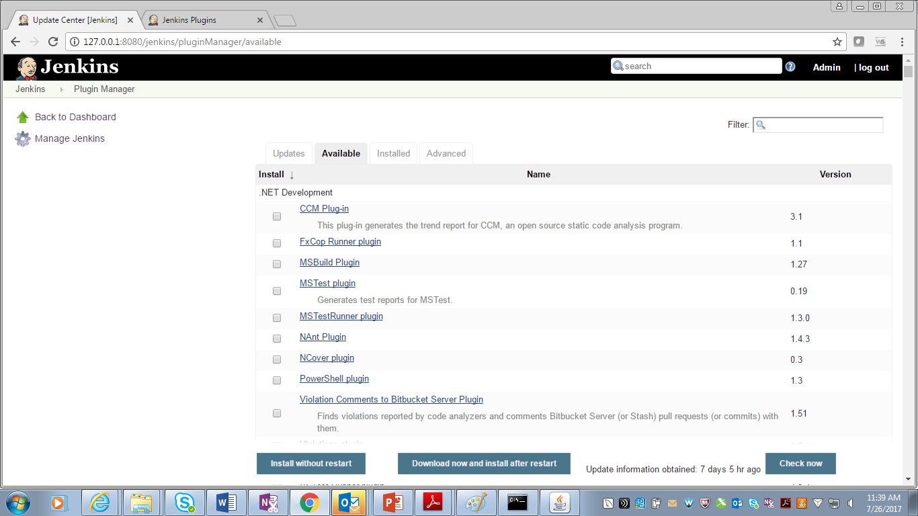

Slide 40
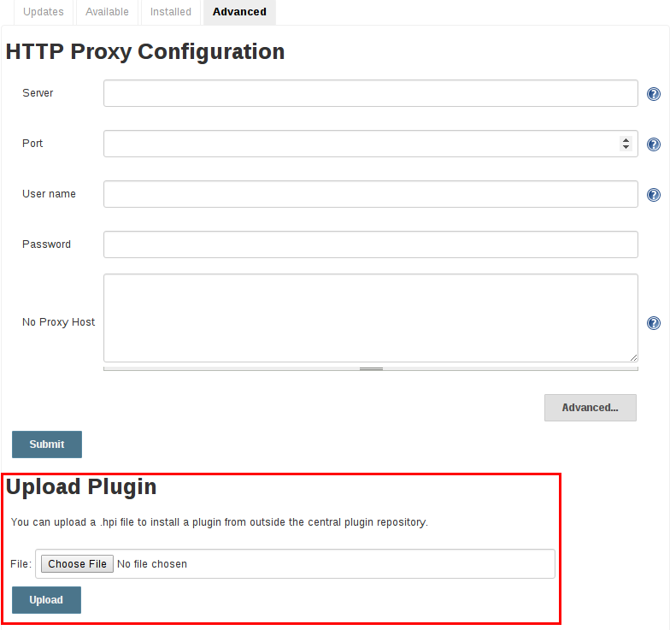
Advanced installation
The Update Center only allows the installation of the most recently released version of a plugin. In cases where an older release of the plugin is desired, a Jenkins administrator can download an older .hpi archive and manually install that on the Jenkins master
From the web UI
Assuming a .hpi file has been downloaded, a logged-in Jenkins administrator may upload the file from within the web UI:
Navigate to the Manage Jenkins > Manage Plugins page in the web UI.
Click on the Advanced tab.
Choose the .hpi file under the Upload Plugin section.
Upload the plugin file.

Slide 41
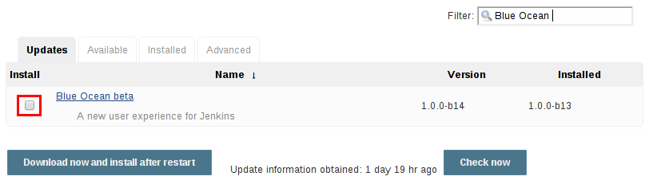
Once a plugin file has been uploaded, the Jenkins master must be manually restarted in order for the changes to take effect.
On the master
Assuming a .hpi file has been explicitly downloaded by a systems administrator, the administrator can manually place the .hpi file in a specific location on the file system.
Copy the downloaded .hpi` file into the JENKINS_HOME/plugins directory on the Jenkins master (for example, on Debian systems JENKINS_HOME is generally /var/lib/jenkins).
The master will need to be restarted before the plugin is loaded and made available in the Jenkins environment.
Updating a plugin
Updates are listed in the Updates tab of the Manage Plugins page and can be installed by checking the checkboxes of the desired plugin updates and clicking the Download now and install after restart button.
 | The names of the plugin directories in the Update Site ^{[1]} are not always the same as the plugin’s display name. Searching plugins.jenkins.io for the desired plugin will provide the appropriate link to the .hpi files.
By default, the Jenkins master will check for updates from the Update Center once every 24 hours. To manually trigger a check for updates, simply click on the Check now button in the Updates tab

Slide 42
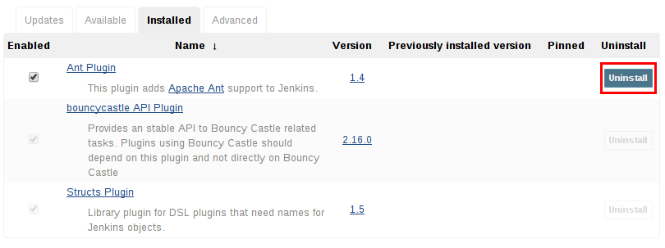
Removing a plugin
When a plugin is no longer used in a Jenkins environment, it is prudent to remove the plugin from the Jenkins master. This provides a number of benefits such as reducing memory overhead at boot or runtime, reducing configuration options in the web UI, and removing the potential for future conflicts with new plugin updates.
Uninstalling a plugin
The simplest way to uninstall a plugin is to navigate to the Installed tab on the Manage Plugins page.
From there, Jenkins will automatically determine which plugins are safe to uninstall, those which are not
dependencies of other plugins, and present a button for doing so.
A plugin may also be uninstalled by removing the corresponding .hpi file from the JENKINS_HOME/plugins directory on the master.
The plugin will continue to function until the master has been restarted.Uninstalling a plugin does not remove the configuration that the plugin may have
created. If there are existing jobs/nodes/views/builds/etc configurations that reference data created by the plugin,
during boot Jenkins will warn that some configurations could not be fully loaded and ignore the unrecognized data.
Since the configuration(s) will be preserved until they are overwritten, re-installing the plugin will result in those
configuration values reappearing.
 | If a plugin .hpi file is removed but required by other plugins, the Jenkins master may fail to boot correctly.

Slide 43
FingerPrints
o What are fingerprints?
o How do fingerprints work?

Slide 44
Jenkins supports file fingerprinting to track dependencies.
When you have interdependent projects on Jenkins, it often becomes hard to keep track of which version of a file is used by which version of a dependency on that file
How does it work?
The fingerprint of a file is simply a MD5 checksum.
Jenkins maintains a database of md5sum, and for each md5sum, Jenkins records which builds of which projects used. This database is updated every time a build runs and files are fingerprinted.
To avoid the excessive disk usage, Jenkins does not store the actual file. Instead, it just stores md5sum and their usages. These files can be seen in $JENKINS_HOME/fingerprints
Configure a job to Record Fingerprint(s) of a file or set of files
Go to your project, click Configure in the left navigation bar, then scroll down to the Post-build Actions section of the job
Click on the button to add a Post-build action.
Select Record fingerprints of files to track usage
3 Scenarios of Fingerprinting usage
1. You develop the BOTTOM project and you want to know who is using BOTTOM #13 in which builds
Go to BOTTOM #13 build page.
Click the "fingeprint" icon of bottom.jar in the build artifacts
You'll see all the projects and builds that uses it.
3. You have the TOP project that builds a jar. You also have the TOP-TEST project that runs after the TOP project and does extensive integration tests on the latest TOP bits. You want to know the test results of TOP #7.
Go to TOP #7 build page.
Click the "fingeprint" icon of top.jar in the build artifacts
You'll see all the TOP-TEST builds that used it.
Click it and you'll be taken to the appropriate TOP-TEST build page, which will show you test reports.
If there's no TOP-TEST builds displayed, then that means TOP-TEST build didn't run against TOP #7. Maybe it skipped TOP #7 (this can happen if there are a lot of TOP builds in a short period of time), or maybe a new TOP-TEST build is in progress.
2. You develop the TOP project and you want to know which build of bottom.jar and middle.jar you are using in TOP #10.
Go to TOP #10 build page.
Click "see fingerprints"
You'll see all the files fingerprinted in TOP #10, along with where they came from.

Slide 45
Artifacts
o How to use artifacts in Jenkins
o Storing artifacts

Slide 46
An artifact is one of many kinds of tangible by-products produced during the development of software.
An artifact might be a binary executable (a JAR or WAR file for a Java project, for example), or some other related deliverable, such as documentation or source code
A build job can store one or many different artifacts, keeping only the latest copy or every artifact ever built.
Archived artifacts can take a lot of disk space, especially if builds are frequent. For this reason, you may want to only keep the last successful one
Jenkins will keep artifacts from the last stable build (if there where any).
Jenkins will keep artifacts from the last stable build (if there where any). It will also keep the artifacts of the latest unstable build following the stable build (if any), and also from the last failed build that happened
Storing Artifacts
Artifcats can be stored externally in Repository Manager like Nexus or Artifactory etc

Slide 47
Using 3rd Party Tools
o How to use artifacts in Jenkins
o Storing artifacts

Slide 48
An artifact is one of many kinds of tangible by-products produced during the development of software.
An artifact might be a binary executable (a JAR or WAR file for a Java project, for example), or some other related deliverable, such as documentation or source code
A build job can store one or many different artifacts, keeping only the latest copy or every artifact ever built.
Archived artifacts can take a lot of disk space, especially if builds are frequent. For this reason, you may want to only keep the last successful one
Jenkins will keep artifacts from the last stable build (if there where any).
Jenkins will keep artifacts from the last stable build (if there where any). It will also keep the artifacts of the latest unstable build following the stable build (if any), and also from the last failed build that happened
Storing Artifacts
Artifcats can be stored externally in Repository Manager like Nexus or Artifactory etc

Slide 49
• Source Code Management
o What are source code management systems and how are they used?
o Cloud-based SCMs
o Jenkins changelogs
o Incremental updates v clean check out
o Checking in code
o Infrastructure-as-Code
o Branch and Merge Strategies
• Testing
o Benefits of testing with Jenkins
o Define unit test, smoke test, acceptance test, automated verification/functional tests
• Notifications
o Types of notifications in Jenkins
o Importance of notifications
• Distributed Builds
o What are distributed builds?
o Functions of masters and agents

Slide 50
Plugins
o What are plugins?
o What is the plugin manager?
• Jenkins Rest API
o How to interact with it
o Why use it?
• Using 3rd Party Tools
o How to use 3rd party tools
• Installation Wizard
o What is the Jenkins Installation Wizard?
o How to use the Wizard?
o Which configurations are covered by the Installation Wizard?
• Using 3rd party tools
o Installation Wizard [new]
• Security
o Authentication versus authorization
o Matrix security
o Definition of auditing, credentials,
and other key security concepts
• FingerPrints
o What are fingerprints?
o How do fingerprints work?
• Artifacts
o How to use artifacts in Jenkins
o Storing artifacts
• Security
• Fingerprints
• Artifacts

Slide 51
Jenkins Usage

Slide 52
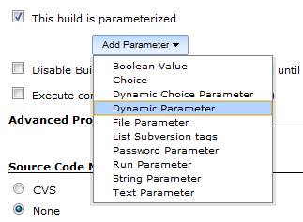
ORGANIZING JOBS IN JENKINS
As the number of projects and teams grow, so does the corresponding number of jobs running on Jenkins. Users find that they need to organize their projects and jobs to make management of them easier.
The Folders plugin allows you to organize jobs into hierarchical folders, much like how you organize files in directories in your file system. This allows you to group related jobs together - you can then group on things like department, projects and jobs in a specific folder. Folders can also define properties that are visible to jobs inside, enabling you to simplify branch and/or workflow management.
Folders allows you to set security permissions on a per folder basis. Roles can be inherited (or filtered out) within the nested folder hierarchy.
PARAMETERIZED BUILD:
Jenkins job can run with parameters that is given as the input to the job running. This feature is useful when a developer wants to run the same Jenkins job for different set of parameters.
To create the parameterized job , This project is parameterized checkbox is selected in the Jenkins job configuration page.
There are different parameter types available, and it is extensible, too. The way parameters take effect is also different depending on the parameter type you choose.

Slide 53
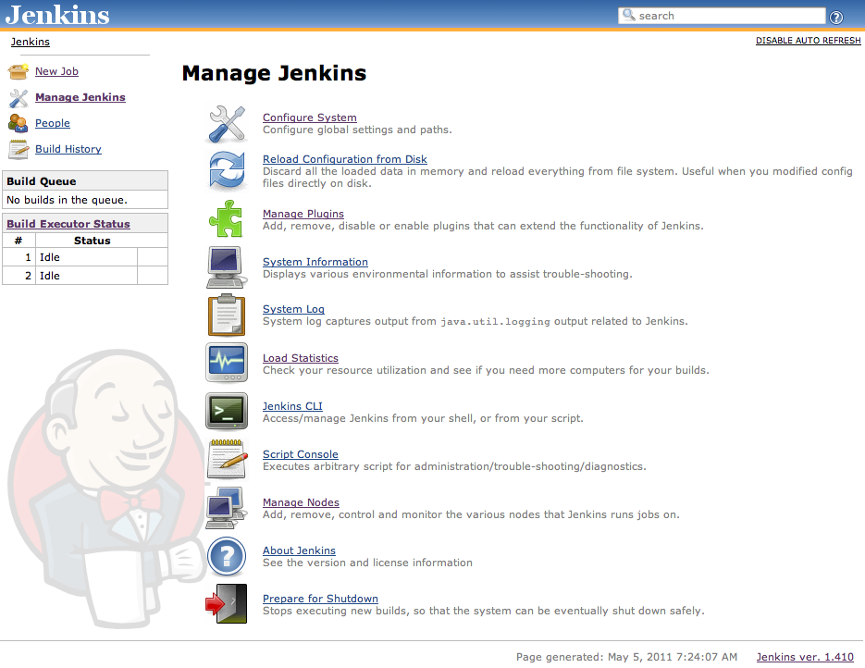
USAGE OF FREESTYLE/ PIPELINE / MATRIX JOBS
FreeStyle /Pipeline: Demo
Matrix Jobs: A multi-configuration project is useful for instances where your builds will make many similar build steps, and you would otherwise be duplicating steps.
Example: Building the application in different environments. Demo Job
BUILD IN JENKINS

Slide 54
SOURCE CODE MANAGEMENT
SCM POLL
The Jenkins job can be made to poll the source code periodically by giving the CRON schedule criteria.
http://www.scmgalaxy.com/tutorials/setting-up-the-cron-jobs-in-jenkins-using-build-periodically-scheduling-the-jenins-job/
Refer for CRON expression format.
Creating Hooks:
The Jenkins job can be configured to trigger the job when there is a change detected in the SCM .
Difference between Poll and Webhooks
Poll: this will trigger a job periodically by referring the CRON expression.
Web Hooks: If a commit is detected in SCM , then the corresponding Jenkins Job will be triggered with a new build. Version control tag:
Application will be stored in SCM along with the Version tag which is helpful in detecting what changes are made at what time and by whom.
TESTING
Code Coverage: there are so many plugins for testing the code coverage, code quality, etc.
Code coverage is an indication of how much of your application code is actually executed during your tests—it can be a useful tool in particular for finding areas of code that have not been tested by your test suites.
Test Reports: Once your build generates test results, you need to configure your Jenkins build job to display them. As mentioned above, Jenkins will work fine with any xUnit-compatible test reports, no matter what language they are written in.

Slide 55
Notifications
Build Notifications
You can configure per job to get notifications for finished or started builds (optional). Notifications can be send to chatrooms or individual users (aka. private messages in IRC).
You can choose from a number of strategies for which build outcomes notification will be send:
all
failure - notifications for failed and unstable builds
failure and fixed - notifications for failed, unstable builds and the first fixed build after that
change - sends notification every time the build outcome changes (e.g. from stable to unstable)
Notify culprits and fixers
If your job is build from a SCM, you can choose to notify:
users who broke the build i.e. commiters to the first failed or unstable build
culprits from a previous build i.e. commiters to a previous failed/unstable build and the current build is still failing/unstable
fixers i.e. commiters to the first stable build after a failed/unstable build
upstream committers: see below

Slide 56
Distributed Builds
This method of build will have Servers as agents to run the jobs
Jenkins architecture is fundamentally "Master+Agent". The master is designed to do co-ordination and provide the GUI and API endpoints, and the Agents are designed to perform the work. The reason being that workloads are often best "farmed out" to distributed servers. This may be for scale, or to provide different tools, or build on different target platforms. Another common reason for remote agents is to enact deployments into secured environments
https://wiki.jenkins.io/display/JENKINS/Distributed+builds

Slide 57
QUICK REFERENCES

Slide 58
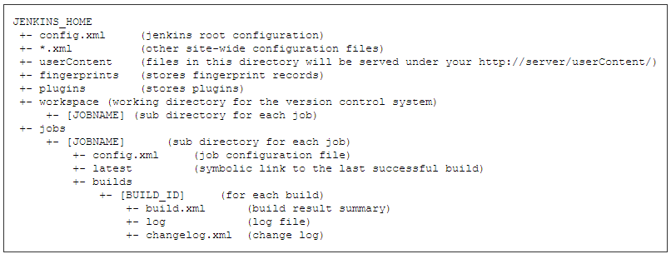
Jenkins Home
By default, this is set to ~/.jenkins, but you can change this in one of the following ways:
Set "JENKINS_HOME" environment variable to the new home directory before launching the servlet container.
Set "JENKINS_HOME" system property to the servlet container.
Set JNDI environment entry "JENKINS_HOME" to the new directory.
Jenkins Directory Structure
TO See All Jenkins Environment Variables
Back up and restore
All the settings, build logs, artifact archives are stored under the JENKINS_HOME directory. Simply archive this directory to make a back up. Similarly, restoring the data is just replacing the contents of the JENKINS_HOME directory from a back up.
Back ups can be taken without stopping the server, but when you restore, please do stop the server.
http://(jenkins_url)/env-vars.html
Start/Stop via REST API(URL):
http://(jenkins_url)/safeRestart – Allows all running jobs to complete. New jobs will remain in the queue to run after the restart is complete.
http://(jenkins_url)/restart – Forces a restart without waiting for builds to complete.
http://(jenkins_url)/exit - Shutsdown Jenkins
http://(jenkins_url)/reload - Reload Jenkins Config(forceful reload)
Start/Stop via CLI:
sudo service jenkins start – To start the Jenkins
sudo service jenkins stop – To stop the Jenkins
sudo service jenkins restart – To restart the Jenkins
sudo service jenkins status – To know the status of Jenkins

Slide 59
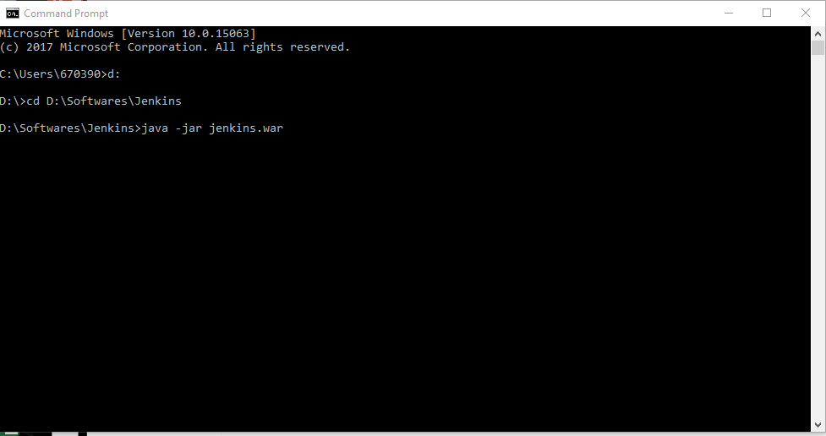

Slide 60
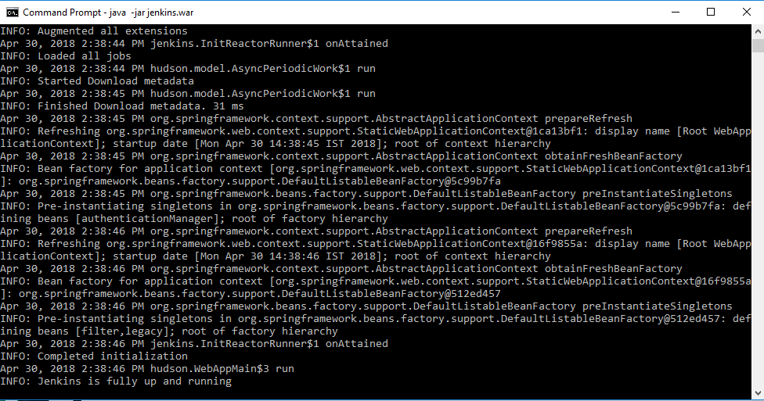

Slide 61
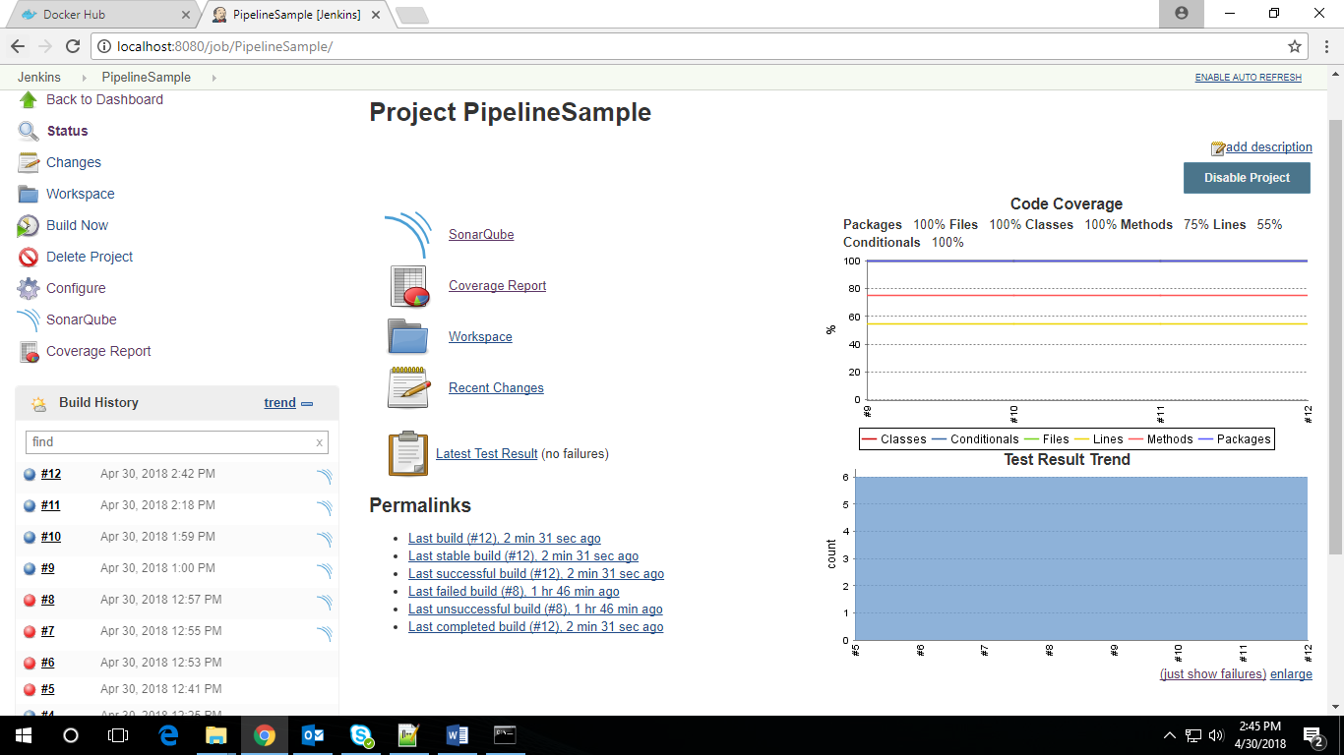

Slide 62
What is Jenkins Pipeline?
jenkins pipeline is a suite of plugins which supports implementing and integrating continuous delivery pipelines into jenkins.
pipeline provides an extensible set of tools for modeling simple-to-complex delivery pipelines "as code" via the Pipeline domain-specific language (DSL) syntax. ^{[1]}
The definition of a Jenkins Pipeline is written into a text file (called a Jenkinsfile) which in turn can be committed to a project’s source control repository.
A Jenkinsfile can be written using two types of syntax - Declarative and Scripted
Gates within a CD pipeline
provide a point for approval before continuing.
Definition of binary reuse, automated deployment, multiple environments
binary reuse – use other components as packaged, artifacts that have passed success criteria
automated deployment – using the same script to deploy to every environment
multiple environments – resources/configuration needed to work: ex: test, qa, prod

Slide 63
Upstreams and downstreams
Triggering jobs from other jobs
Build other projects
comma separated list of jobs
can specify to trigger only on good builds, good builds + unstable builds and always (even on failure)
all jobs share same trigger
Trigger parameterized build on other projects
comma separated list of jobs
can control based on success, unstable, failure only, aborted, etc
can set up multiple triggers so each set has different rules on when to run
parameter types include boolean, string, from a property file, current build parameters, etc
can pass through information like slave or git/svn trigger info
Setting up the Parameterized Trigger plugin
check “this build is parameterized” and setup parameters
can use node to specify slave by name from select list or label to specify slave’s build label
Upstream/downstream jobs
if a depends on b, b is the upstream job

Slide 64
Triggering
Triggering Jenkins on code changes
for a commit build
Difference between push and pull
pull - set up a scm polling trigger
push – set up a hook from the repository to trigger job
When to use push vs pull
pull for when you don’t control the repository or polling is ok
push for when you need an immediate build or don’t want to waste resources on polling

Slide 65
Declarative Vs Scripted
jenkinsfile (declarative pipeline) the pipeline block defines all the work done throughout your entire Pipeline.
in scripted pipeline syntax, one or more node blocks do the core work throughout the entire pipeline
steps is Declarative Pipeline-specific syntax that describes the steps to be run in this stage.
node is Scripted Pipeline-specific syntax that instructs Jenkins to execute this Pipeline (and any stages contained within it), on any available agent/node. This is effectively equivalent to agent in Declarative Pipeline-specific syntax.

Slide 66
stage - the stage step remains but is now focused on grouping steps and providing boundaries for pipeline segments.
lock - the lock step throttles the number of concurrent builds in a defined section of the pipeline.
milestone - the milestone step automatically discards builds that will finish out of order and become stale.
sh -a pipeline step (provided by the pipeline: nodes and processes plugin) that executes the given shell command.
junit - another a pipeline step (provided by the junit plugin) for aggregating test reports.

Slide 67
Visualization
Options to visualize jobs’ relationships
build pipeline view – shows upstream/downstream dependencies for one job
a pipeline automatically creates a stage view – can click to see “full stage view”
delivery pipeline view – not on exam? – shows more details about stages
When to use various options for visualizing jobs’ relationships
can restrict to only include successful builds
Information offered by a build pipeline view
dependencies
status
when run
How to set up build pipeline visualization
create a new view
choose job to start from
can also include in a dashboard view so have more than one per page

Slide 68
Promotions
Promotion of a job
can run steps after a gate
ex: archive artifacts, deploy, etc
Why promote jobs?
way of communicating a build is good
How to use the Promoted Builds plugin
promote builds plugins lets you specify actions that require approval
adds promotion status link when check “promote builds when…”
approvals include manually, automatically, based on downstream/upstream builds
can run multiple build steps (or post build actions) to run after approval – retry-able independently. like a separate build.
see icon once approved or if steps after approval fail
can have multiple promotion processes

Slide 69
Folders
How to control access to items in Jenkins with folders
role based access control can control folder
can control level as current/child/grandchild
Referencing jobs in folders
<jenkinshome>/job/folder/job/name

Slide 70
Parameters
Setting up test automation in Jenkins against an uploaded executable
file parameter in parameterized job
prompted to upload it when running manually
Passing parameters between jobs
can type parameters, use property file, etc
Identifying parameters and how to use them: file parameter, string parameter
string parameter referred to by variable name ${test}
file parameter placed in the workspace in the parameter name
Jenkins CLI parameters
download jar from <jenkins>/jnlpjars/jenkins-cli.jar
run as java –jar jenkins-cli.jar –s <jenkinsurl> help
add –nokeyauth if don’t want to use ssh key

Slide 71
Pipeline Global Libraries
pipeline has support for creating "shared libraries" which can be defined in external source control repositories and loaded into existing pipelines.
a shared library is defined with a name, a source code retrieval method such as by scm, and optionally a default version. the name should be a short identifier as it will be used in scripts.
Shared Libraries, may still be used via the Legacy SCMoption. In this case, include ${library.yourlibrarynamehere.version}
the best way to specify the scm is using an scm plugin which has been specifically updated to support a new api for checking out an arbitrary named version (modern scm option).
Only entire pipeline`s can be defined in shared libraries as of this time. This can only be done in `vars/*.groovy, and only in a call method. Only one Declarative Pipeline can be executed in a single build, and if you attempt to execute a second one, your build will fail as a result.
global shared libraries
folder-level shared libraries
automatic shared libraries

Slide 72
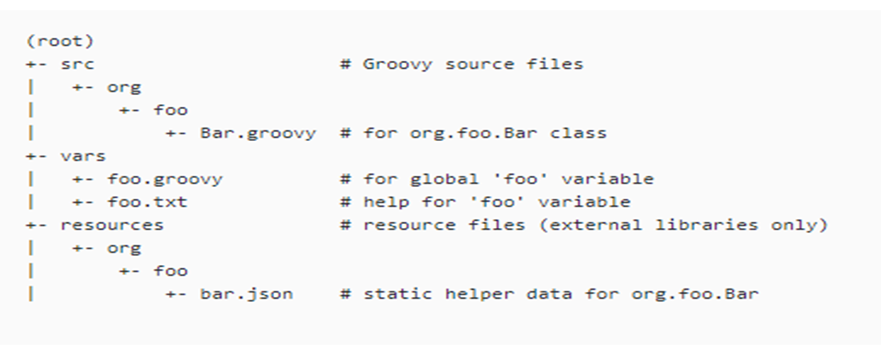
Directory structure

Slide 73
Distributed builds architecture
run jobs on slave
more secure because jobs run on slave
more scalable because can add slaves
vertical growth – master is responsible for more jobs
horizontal growth – creation of more masters
recommend to virtualize slaves, but not master for performance

Slide 74
fungible (replaceable) slaves & master-slave connectors and protocol
Fungible (replaceable) slaves
can configure third party tools to automatically install on slaves
best practice is to make slaves interchangeable, but can tie jobs to slaves
Master-slave connectors and protocol
ssh connector – preferred option. slaves need sshd server and public/private key
jnlp/tcp connector – java network launch protocol start web agent on slave through jws (java web start). can start via browser or os service
jnlp/http connector – like jnlp/tcp except headless and over http
custom script – launch via command line

Slide 75
Cloud slaves
ec2 for amazon cloud
jcloud – for other clouds
Containerization
docker image to deploy/run application
“build inside a docker container” option
Traceability
docker traceability plugin uses fingerprints for images
High availability
master must be on network attached storage device
don’t do builds on master or at least not with workspace under jenkins_home
haproxy serves as the reverse proxy

